Slide 1


OpenText Analytics iHub For Call Center Monitoring
Notes:
BIRT provides today’s enterprise with an effective means of proactively managing every aspect of organizational performance.
In this example BIRT is used to monitor Customer Call Center Operations for a large Financial Services company. BIRT-based dashboards consolidate and summarize information from various call center systems across the firm, depicting the current status of various metrics such as call volume and minutes in easy to understand visualizations.
There are 2 reports that can be used for interactive viewing.
1. Vendor Call Detail Report – this can be brought up from either the Call Volume Analysis Tab (specific vendor)
OR from the Call Volume Insight tab (all vendors)
2. Call Center Activity Detail – Provider SLA tab by selecting the performance index line in the Moving Daily Average chart.

Slide 2
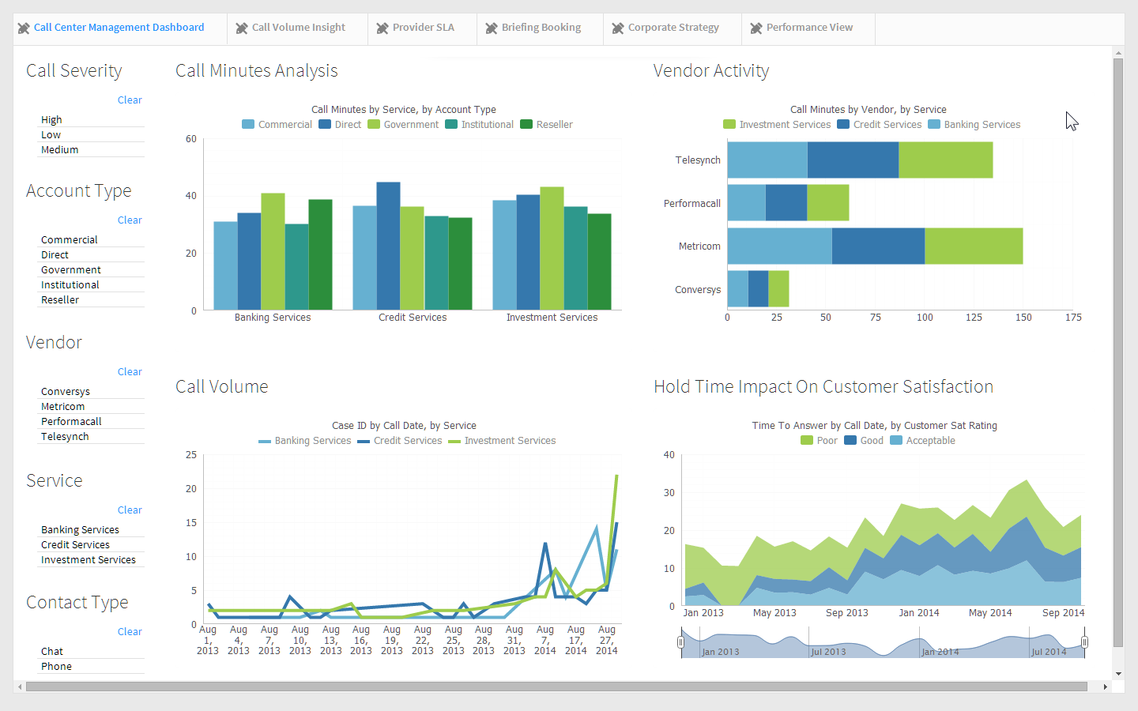
Notes:
Call Center Management Tab:
The dashboard visualizations are driven by an intelligent in-memory data model. The model understands the relationships in the data, and contextual selectors on the page allow the user to change the context and focus of the entire dashboard with point-n-click ease.
The dynamic nature of the dashboard enables discovery of issues and problems and provides a more powerful view of operations than a simple static display.

Slide 3
Notes:
Users experience visual dashboards which display important metrics across the call center including
Call Minute Analysis (top left)
Vendor Activity (top right)
Call Volume (bottom left)
Customer Satisfaction (bottom right)
Multiple selectors provide easy control of the information on the dashboard enabling better insight into operations.
Call Severity
Account Type
Vendor
Service
Contact Type
We can quickly see that we are experiencing poor customer satisfaction (lower right gadget, green).

Slide 4
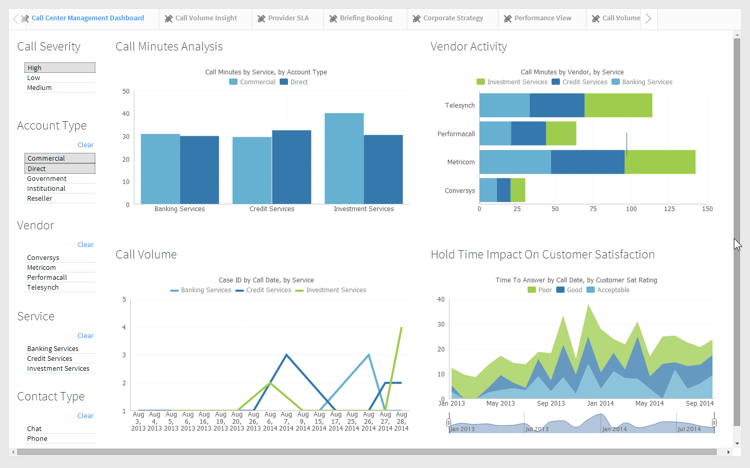
Notes:
One important metric is call minutes. An efficient call center spends the least amount of time on each call necessary to resolve an issue, so that they can service more customers and reduce hold time for new calls. High Call Minutes will translate to poor customer satisfaction.
We want to focus on our commercial & direct customers who have high severity calls.
Select:
Acount Type: Direct, Commercial
Call Severity: High
Quickly see our largest problem area is investment services which is bad because this our most profitable part of our business.

Slide 5
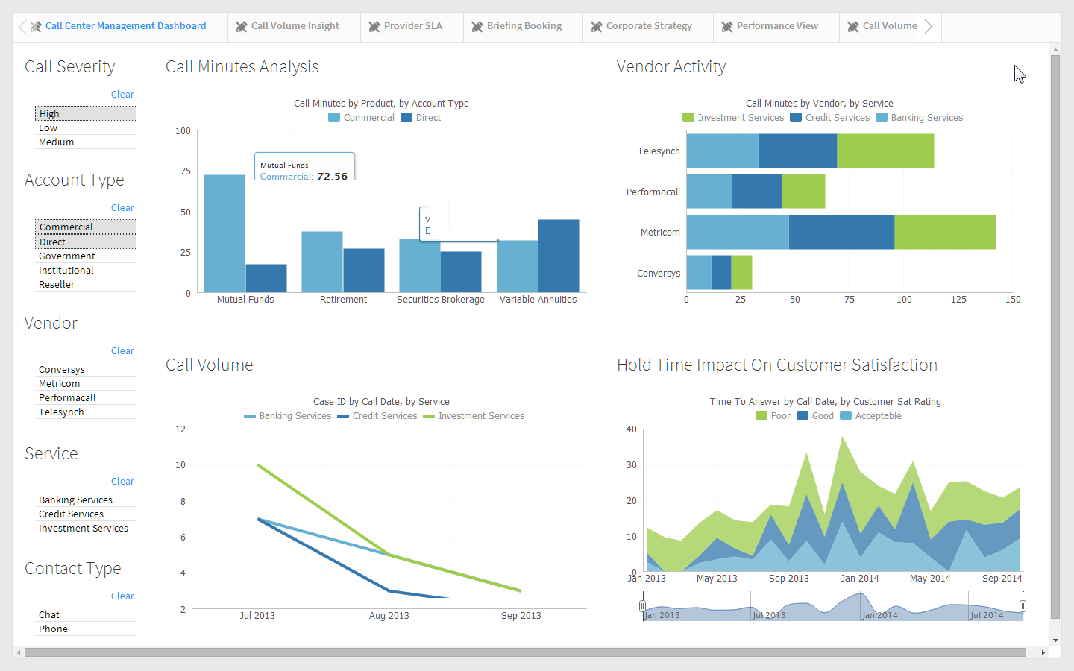
Notes:
Drill down on Investment Services.
The charts are smart, they also understand the relationships of the data and allow the user to drill in place to lower levels of detail. Here we see that there’s an inordinate number of minutes spent dealing with calls regarding mutual funds. We need to dig deeper and get control of the issue.

Slide 6
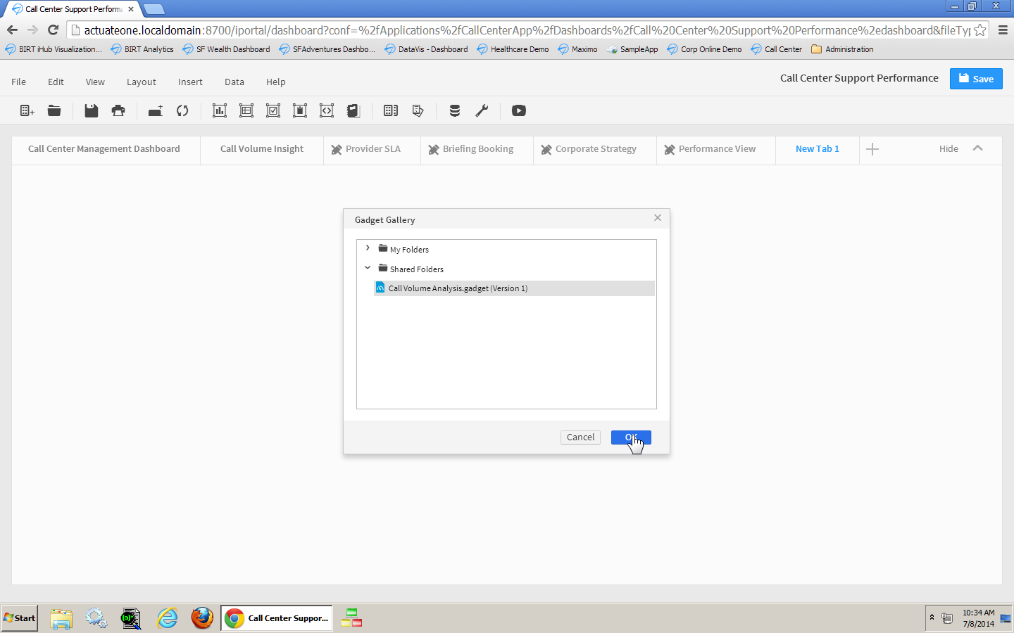
Notes:
Analyzing the Call Minutes
User can create and modify their own experience – adding new visualizations from a gallery of information assets.
Here we will add a new crosstab gadget depicting call volume by product.
Add a new tab – add gadget
To drill into this further, let’s use a pre-created gadget “Call Volume Analysis”.
Click “+” for new tab
Click Add Gadget
Select “CallVolumeAnalysis.gadget”

Slide 7
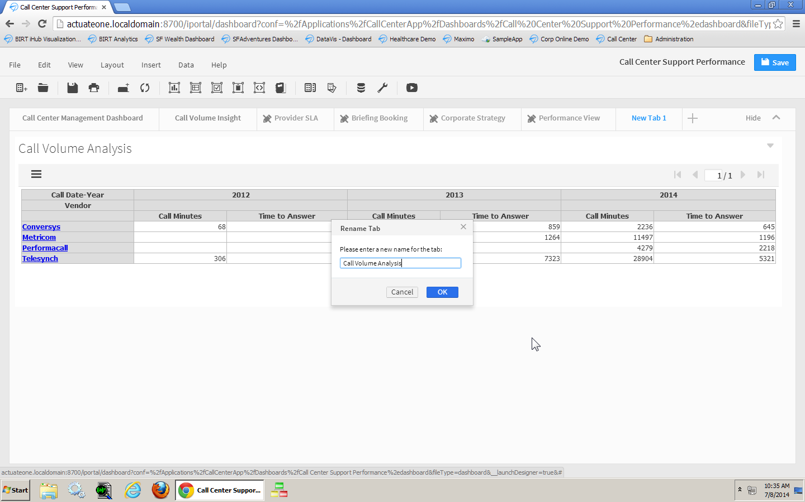
Notes:
Change layout to 1 column
Name tab to “Call Volume Analysis”
Move to 2nd tab
User can change their view …..

Slide 8
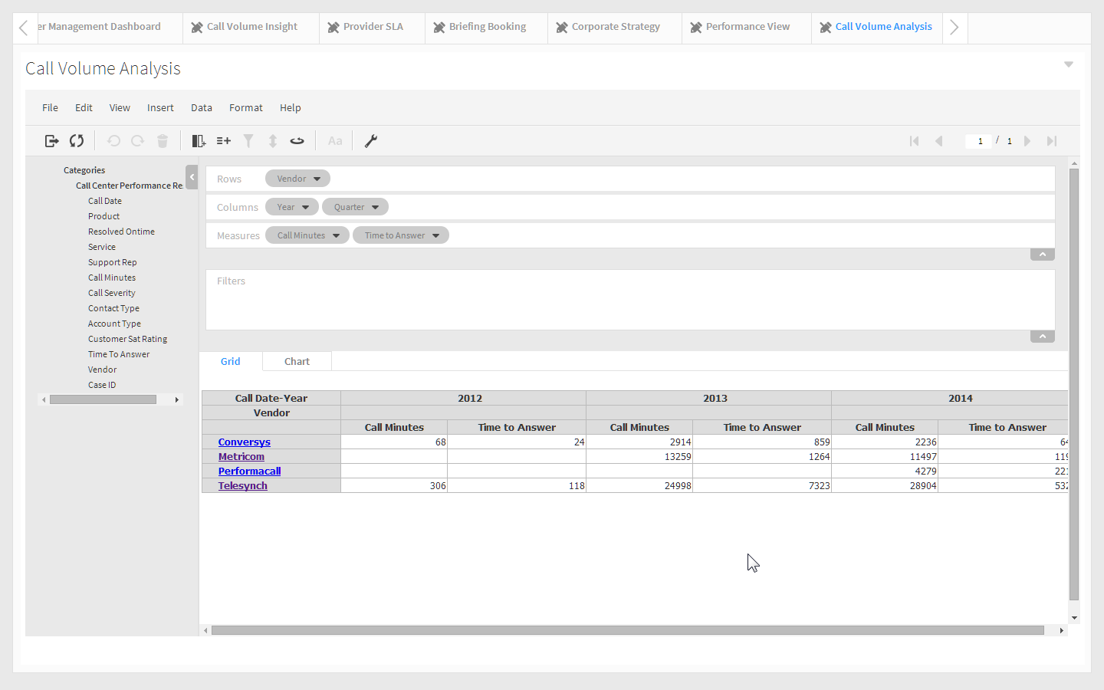
Notes:
Double click to open analyzer
Measures should show as above: Call Minutes … remove Time to Answer.
We want to compare our vendors so we will put them on the rows.
Crosstab visualizations provide a window to the raw data.
Opening the crosstab in Analysis Mode launches it in a dynamic pivot table. The interface allows the user to pivot the table, add new dimensions and measures, and drill into the hierarchies in the data model, which provide very granular analysis of the data. All dimensions and measures are drag-n-drop elements that can be added to the visualization adjusting it on-the-fly.

Slide 9
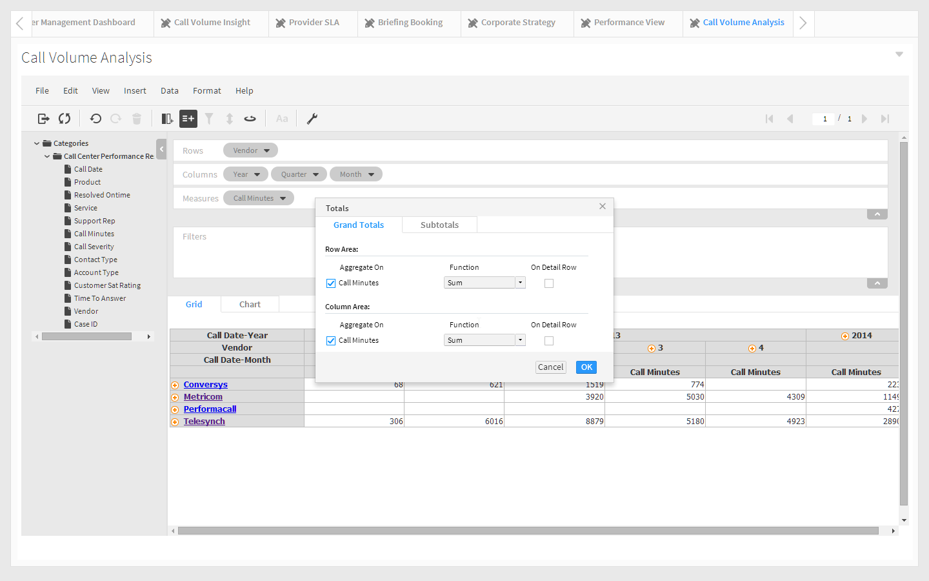
Notes:
Expand 2013 to show quarters
Add totals

Slide 10
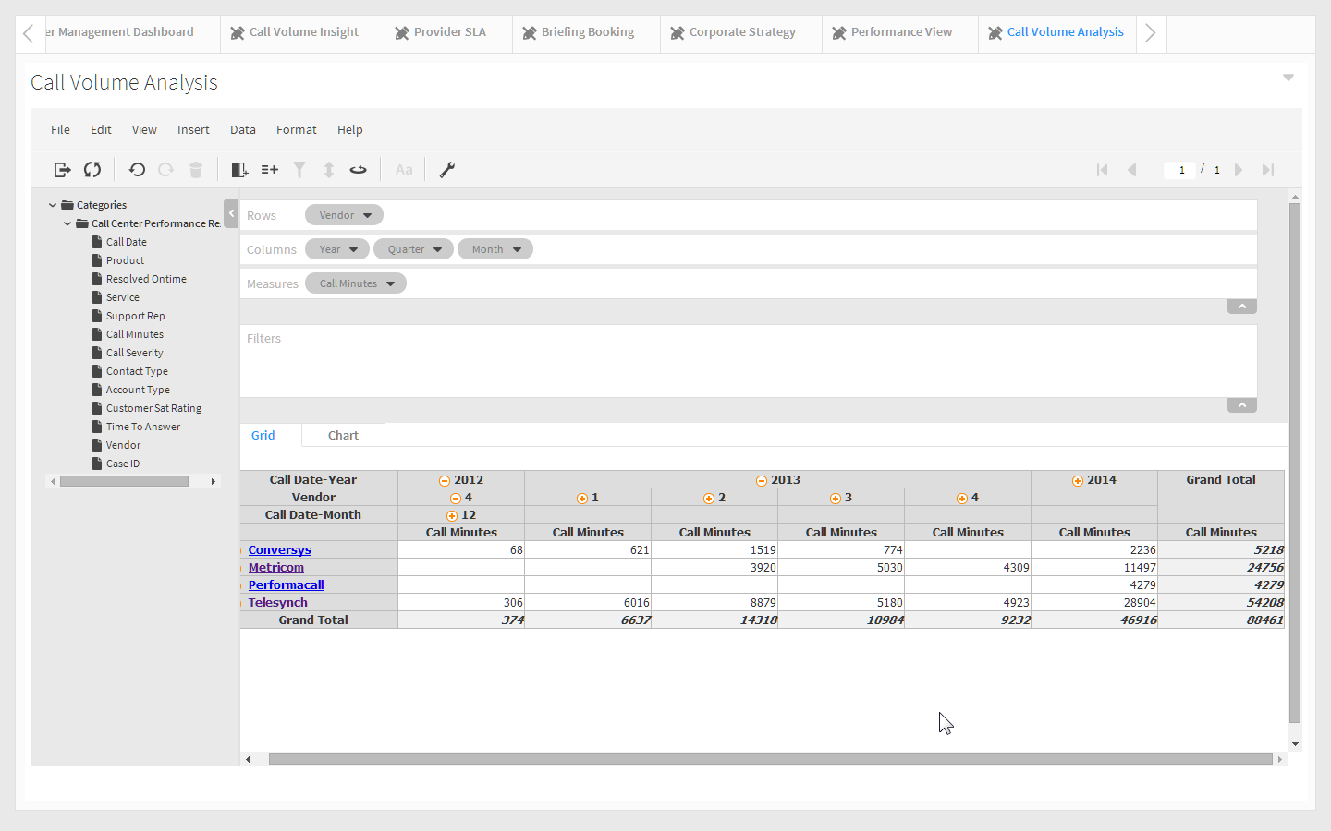
Notes:
Looks like Telesynch lead the pack in minutes last year, and the totals has increased this year even after bringing on Conversys and Performacall, two other vendors, to help spread the load....

Slide 11
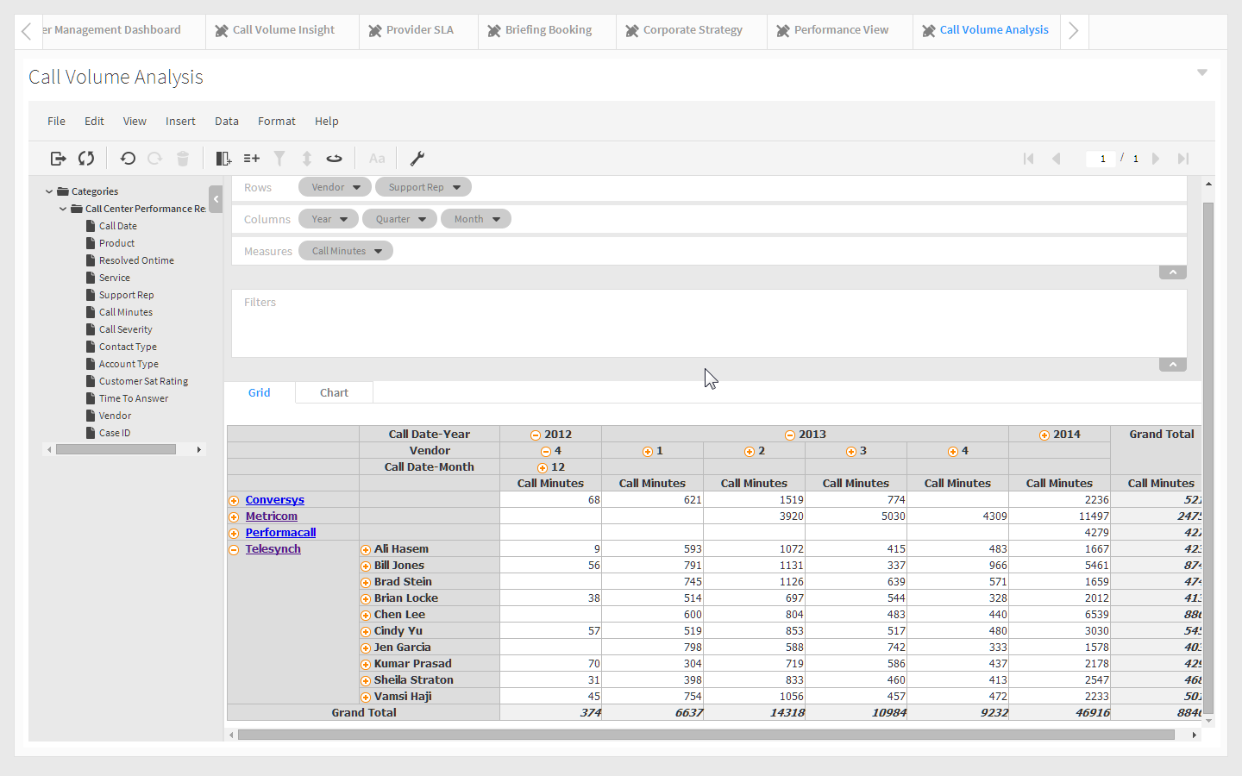
Notes:
Expand Telesync. (Do NOT click on the vendor name, click on the + to the left of it)

Slide 12
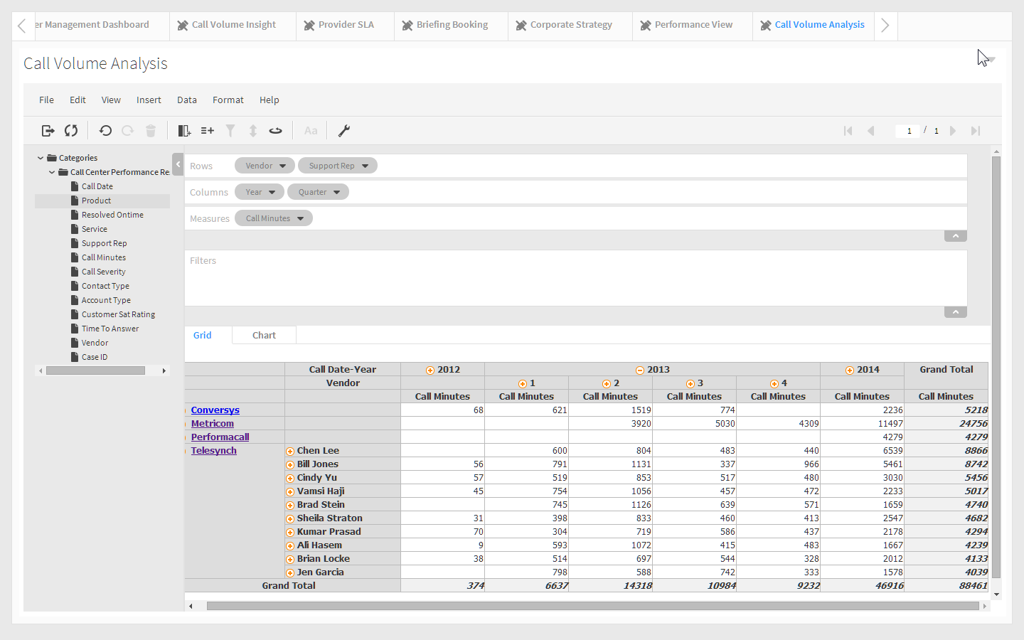
Notes:
Click the grand totals and sort descending.
We can pretty quickly see that Chen Lee and Bill Jones have a much higher Call Minute count than other support reps.
We've made an important discovery and probably need to get the Telesynch team into training to get the issue under control.

Slide 13
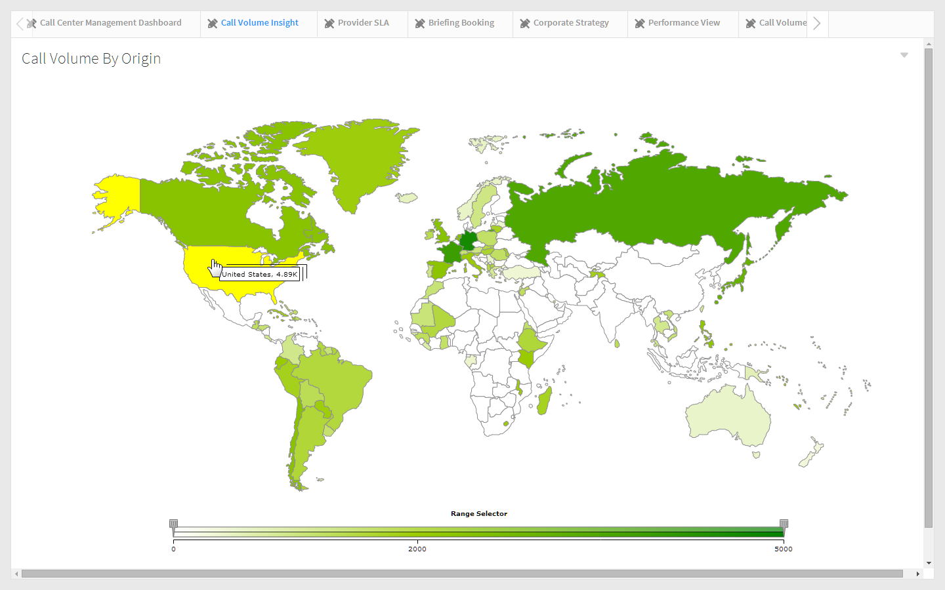
Notes:
Call Volume Insight Tab:
Let’s you see the calls by origin.
Range selector enables you to zero in on the countries w/ desired calls – color coded white to dark green

Slide 14
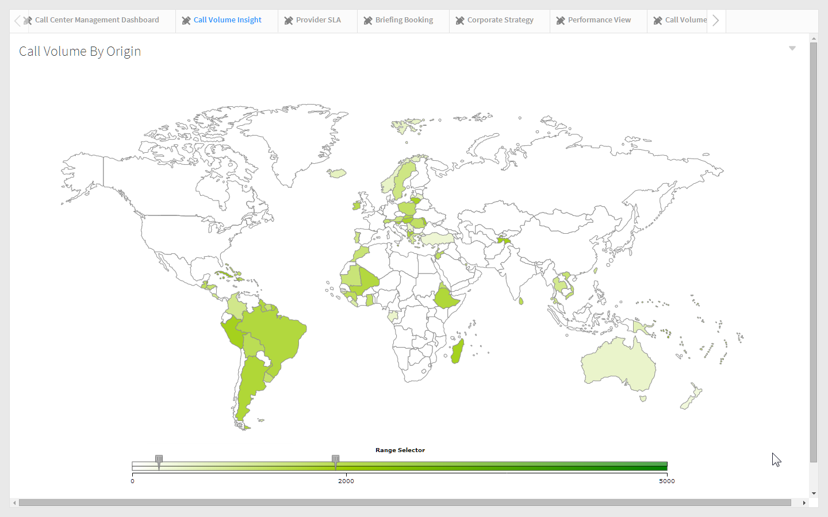
Notes:
Change range selector to see what countries we may want to target in the future.

Slide 15
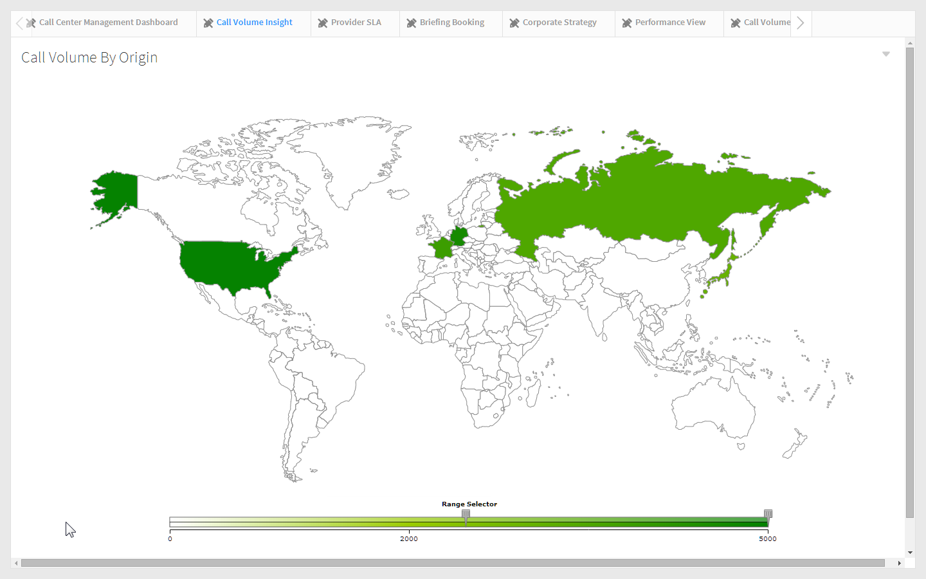
Notes:
Can easily determine where the highest (and lowest) call volume is coming from. With the lowest you can direct your efforts with trying to get new customers.
To see countries with highest amount of call volume – slide range selector above 2000. Notice the countries with less than that turn to white and we are now looking at the US, France, Germany, and Russia.
Drill on any country to bring up the Vendor Call Detail Report.

Slide 16
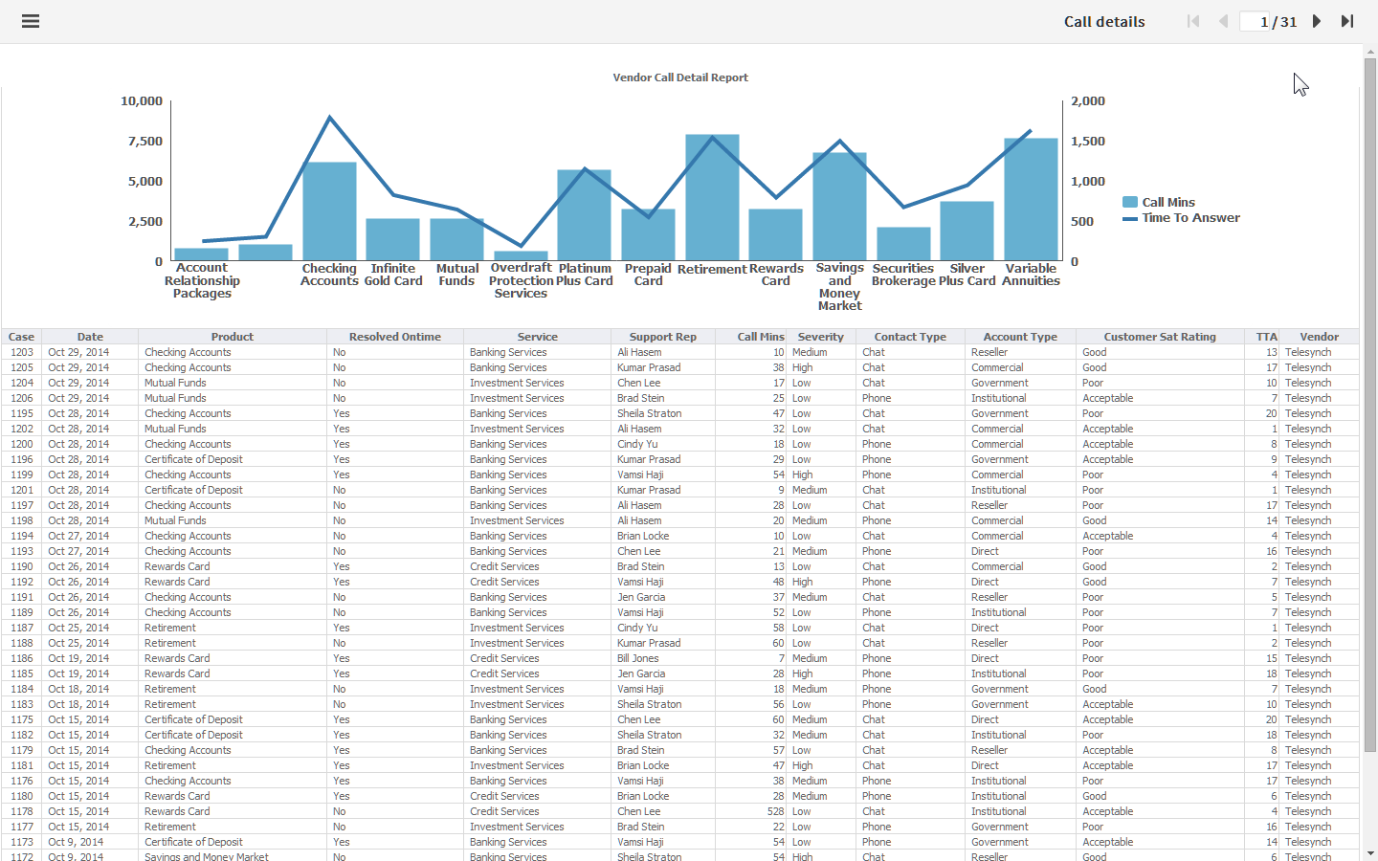
Notes:
Vendor Call Detail Report – This report shows the detail information for the calls. Case, Product, Satisfaction Rating, Vendor are just some of the fields in this report.
(this report does not come up with interactivity on by default)
There are 2 places you can bring up this report.
1. From the Call Volume Insight tab - world map - shows ALL Vendors
2. Call Volume Analysis Xtab (shows selected vendor)

Slide 17
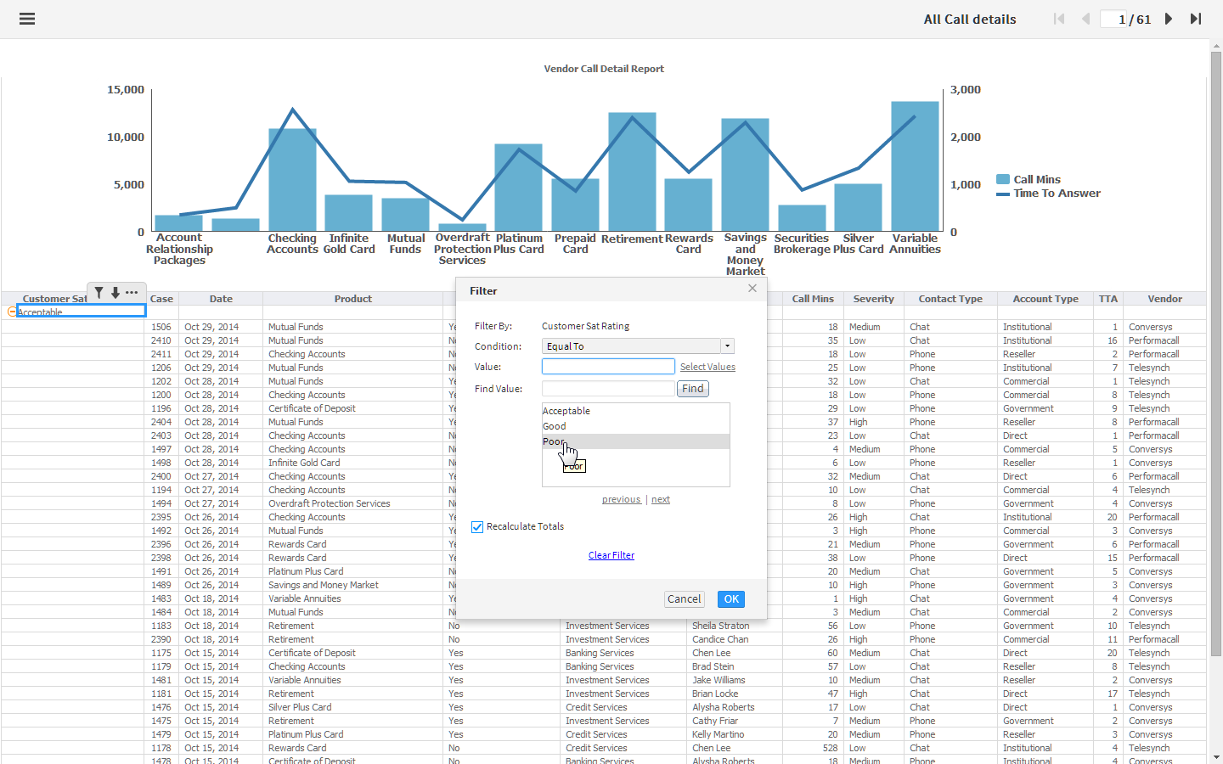
Notes:
Show interactive viewer.
Group on Satisfaction Rating
Filter on Satisfaction Rating = Poor.

Slide 18
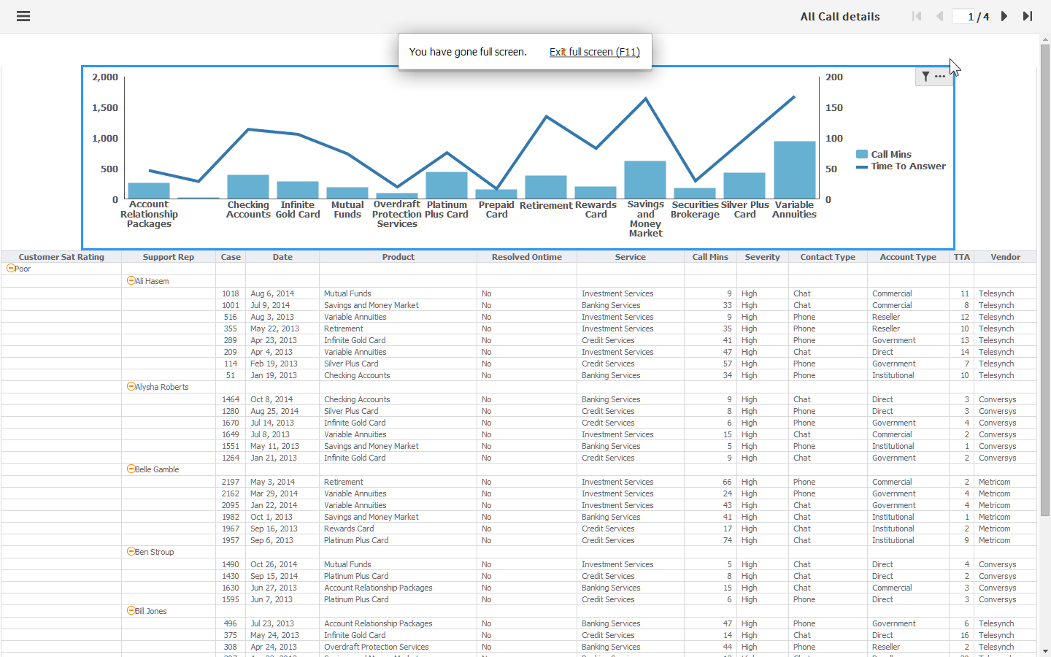
Notes:
Group on Support Rep
Filter on Severity = High.
Filter on Resolved Ontime = No

Slide 19
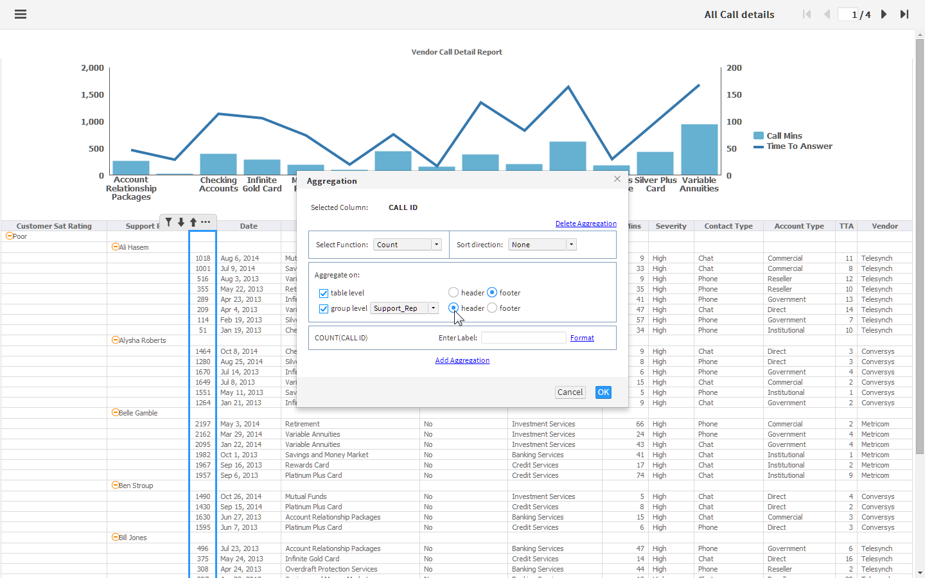
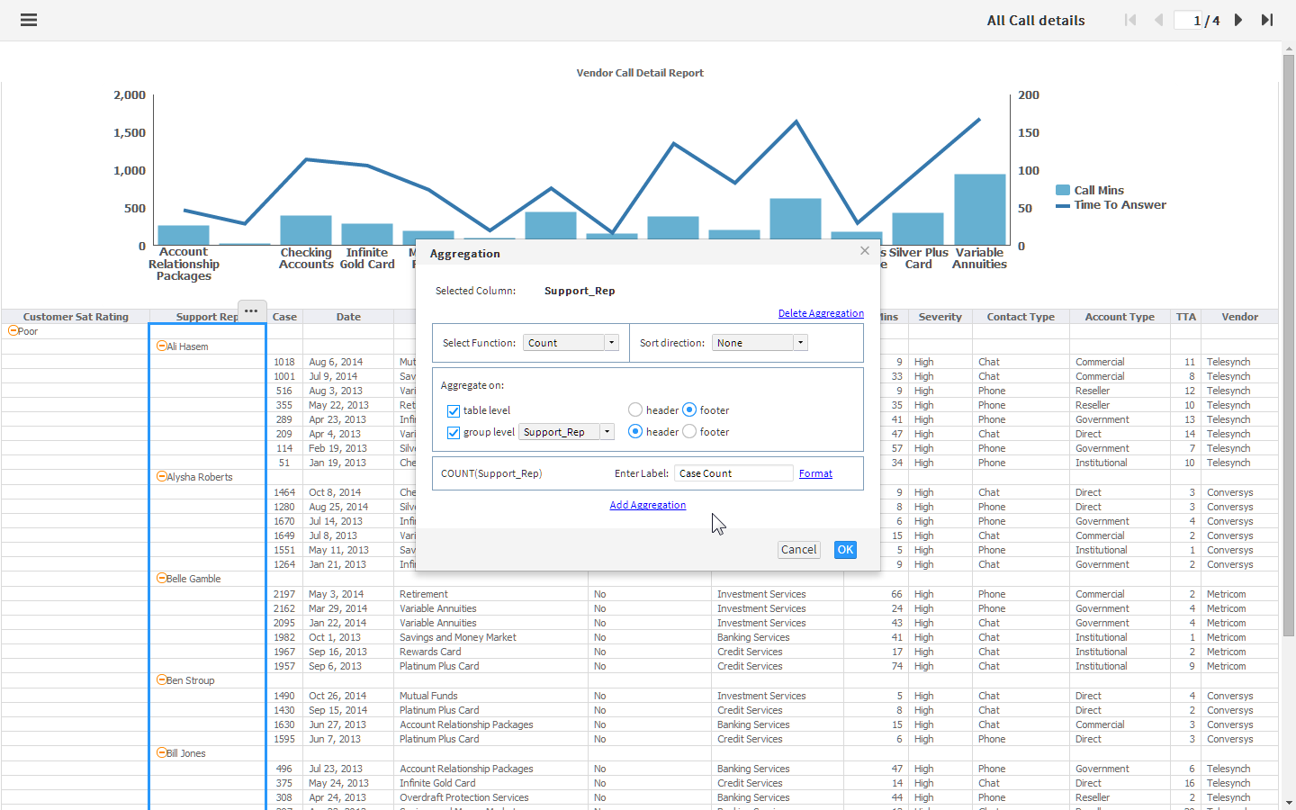
Notes:
Aggregate on Support Rep.
Function: Count
Aggregate On: Group level “Support_Rep”; Header

Slide 20
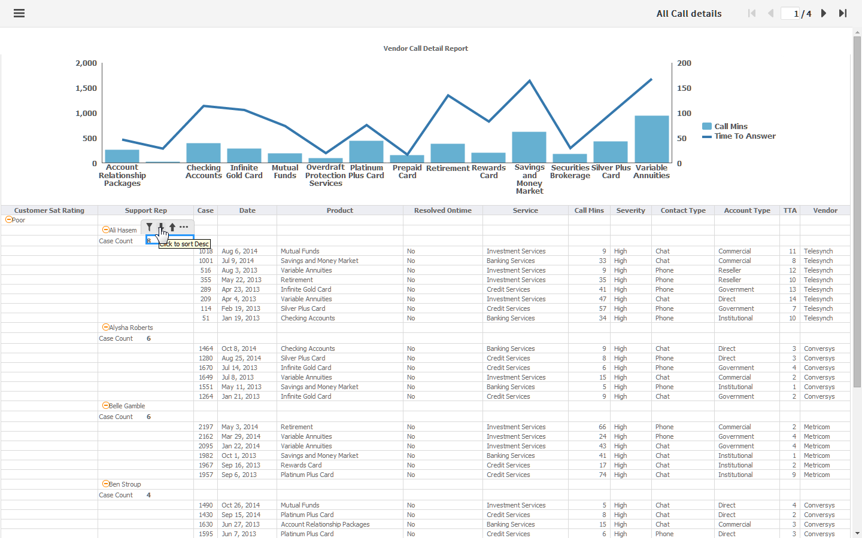
Notes:
Sort Descending

Slide 21
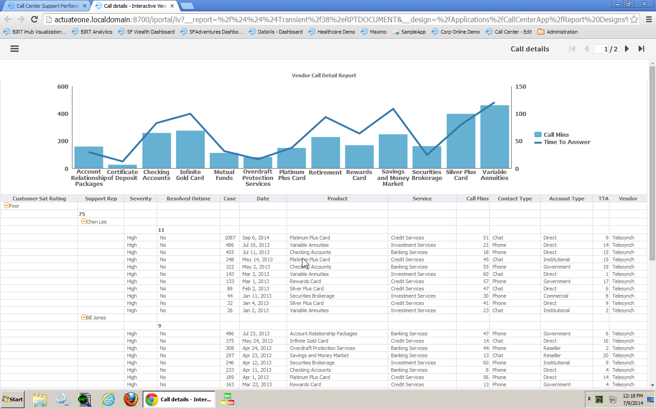
Notes:
With a few clicks we can easily determine pertinent information.
Chen Lee & Bill Jones head up the list for unsatisfied customer.
We could additionally look to see which products or services are being affected. Is it a question of Telesynch training ??

Slide 22
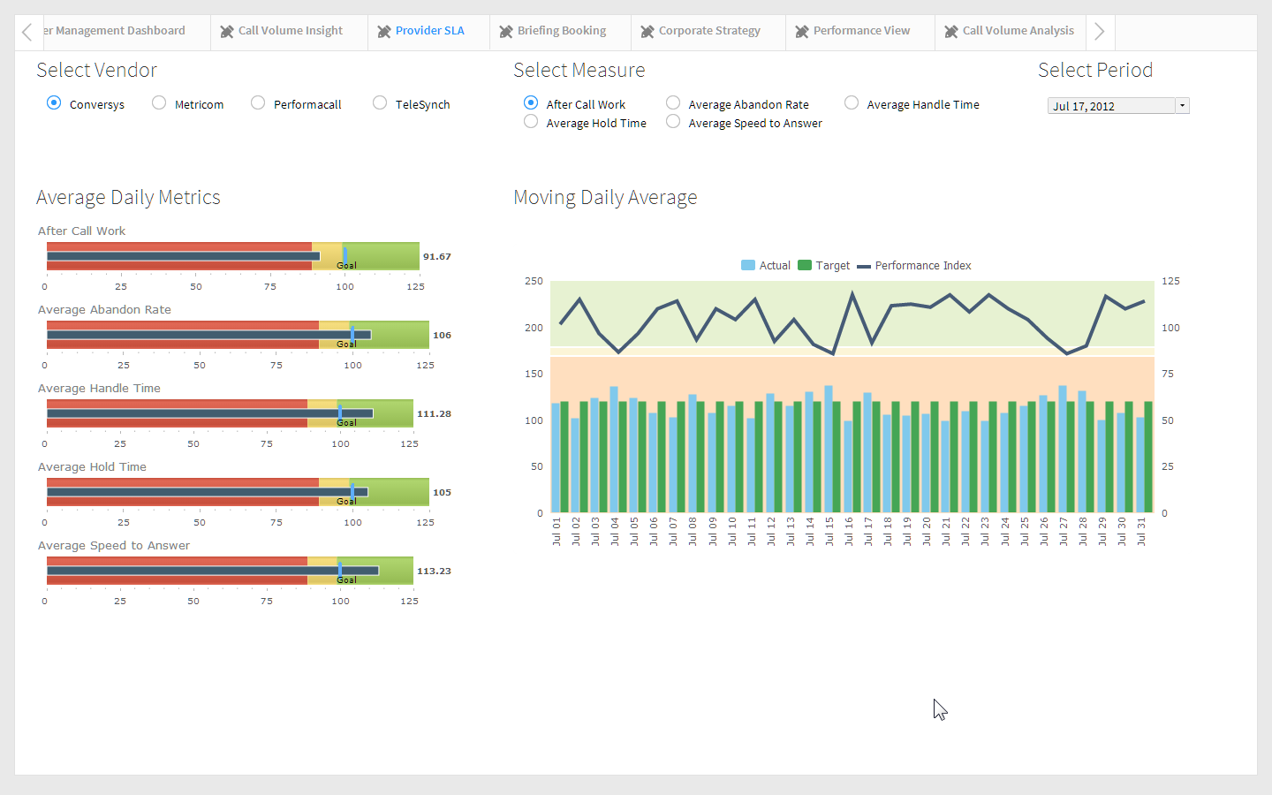
Notes:
Provider SLA tab:
Lets fast forward a bit with regard to our operational performance monitoring capabilities, the next logical step is to actually measure specific metrics around problem areas with our vendors.
Now that we've discovered issues thanks to the analytic dashboards, our organization has been able to create KPIs by establishing goals and targets for our outsourced providers, and then measure their performance against those targets. BIRT has a powerful calculation engine that maintains measures, targets and comparisons for all KPIs across the organization, enabling easy monitoring of our vendors performance.
The bullet charts show our metrics that we are following (After Call Work, Avg Abandon Rate, Avg Handle Time, Avg Hold Time, Avg Speed to Answer) for the selected vendor and period.
The chart shows our actual to target value, as a moving 3 day avg,. Additionally the line chart shows the performance index for the selector vendor & measure. (Selecting a vendor, causes the average daily metrics and moving daily average charts to change to reflect the vendor’s kpis).
When the line displays in green – they are meeting their kpis. When the line is in red – they are following well below their kpis.

Slide 23
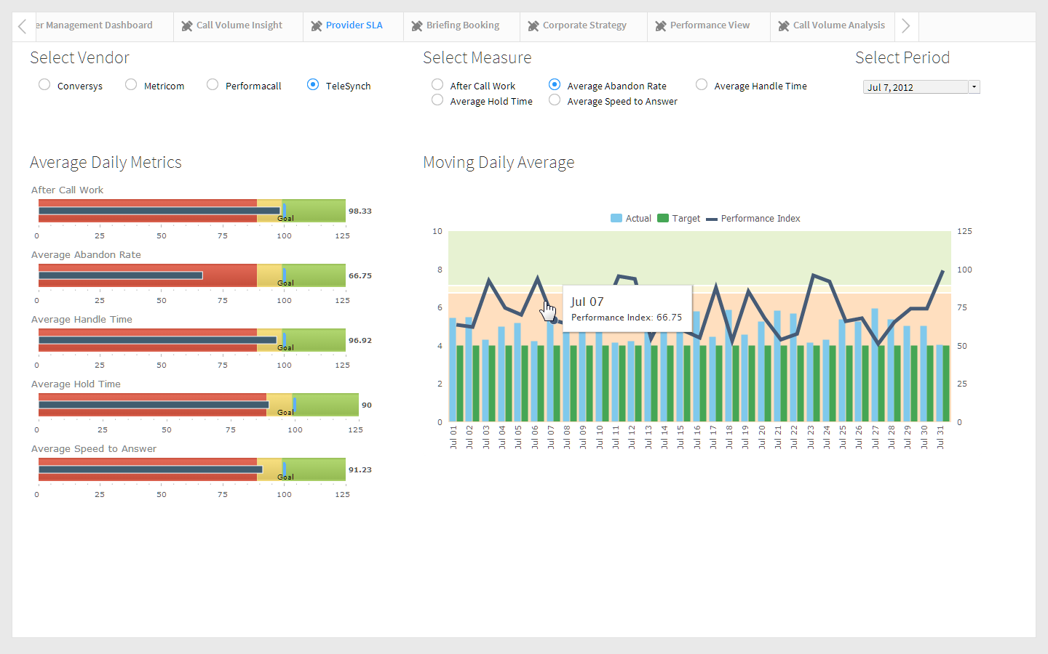
Notes:
Vendor - Telesync.
Measure – select after call work, average hold time, finally land on average abandon rate.
Measure – Average Abandon Rate
Period – July 7th
We can see that Telesync is doing well on their performance metrics for after call work, and average hold time. However, their metrics on average abandon rate are will under performance.

Slide 24
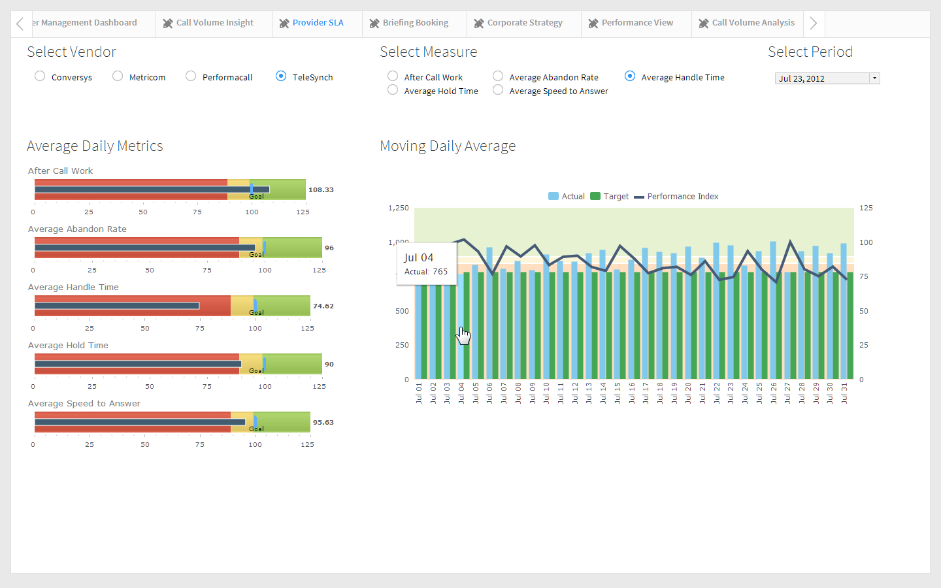
Notes:
Hover over the blue bar on July 21. (the link doesn’t work from the green bar).
Selecting this link will bring up the sla’s for the selected vendor and metric.

Slide 25

Notes:
Click on the performance line.

Slide 26
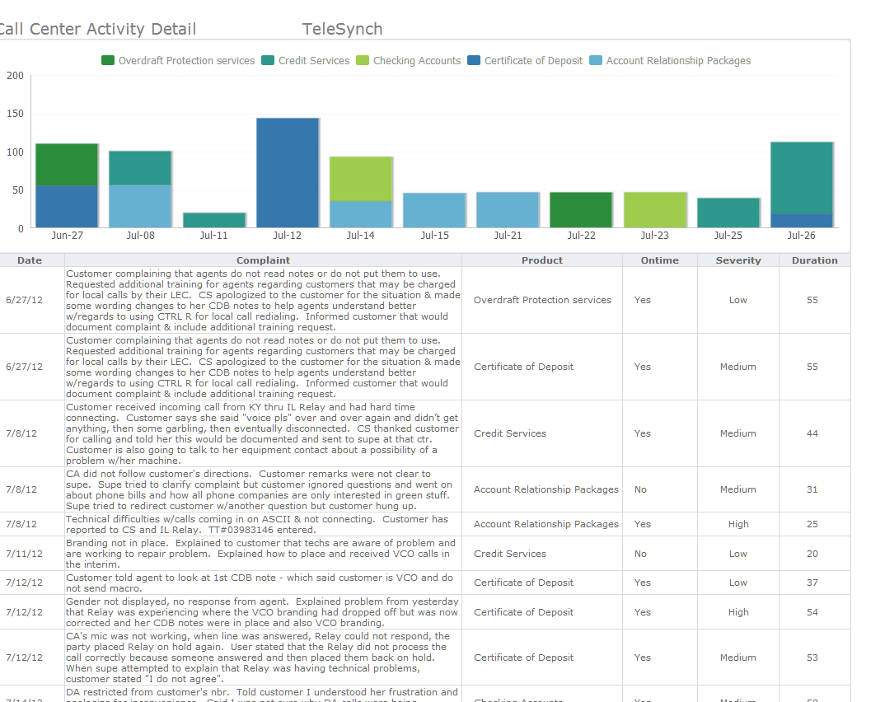
Notes:
This will bring up the call center activity detail for the specified vendor.

Slide 27
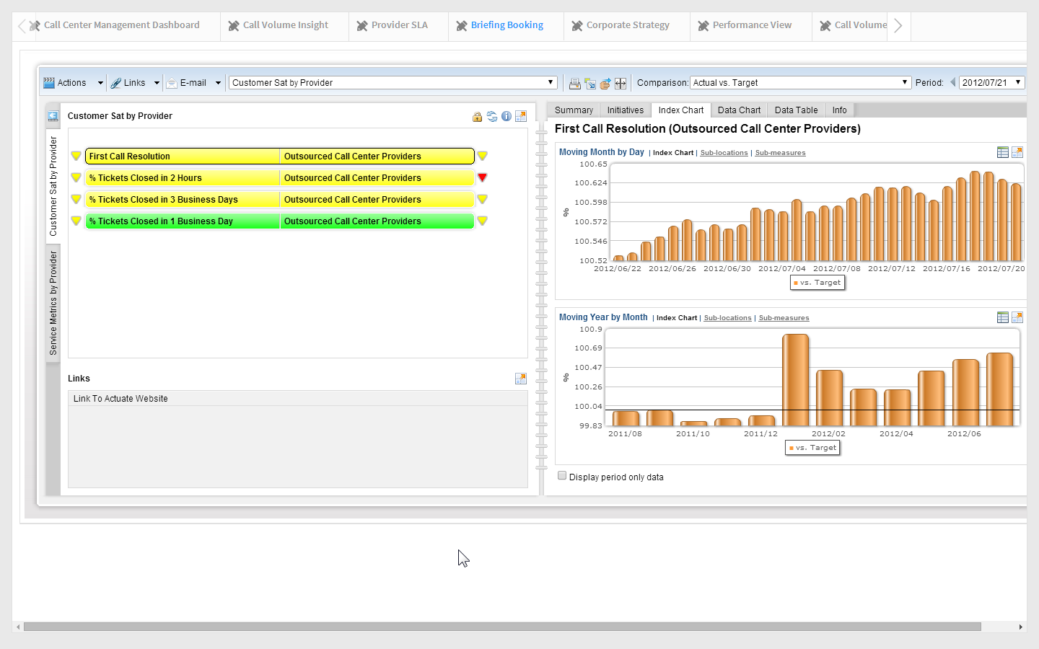
Notes:
Now that we're leveraging BIRT for KPI monitoring, we can take advantage of the Briefing Book to organize and track our KPIs in a hierarchical framework.
The briefing book is an ideal way for stakeholders to monitor KPI's as it represents the metrics as color coded MEASURES that roll up to top level corporate strategies.
Additionally the briefing book is organized into "pages" that the user can define for themselves, making pages for "ALL GOOD" or "ALL BAD" measures, or "ALL DOWNTRENDING MEASURES". Here we've gathered together the measures focused on the call center and customer satisfaction into pages in my book.

Slide 28
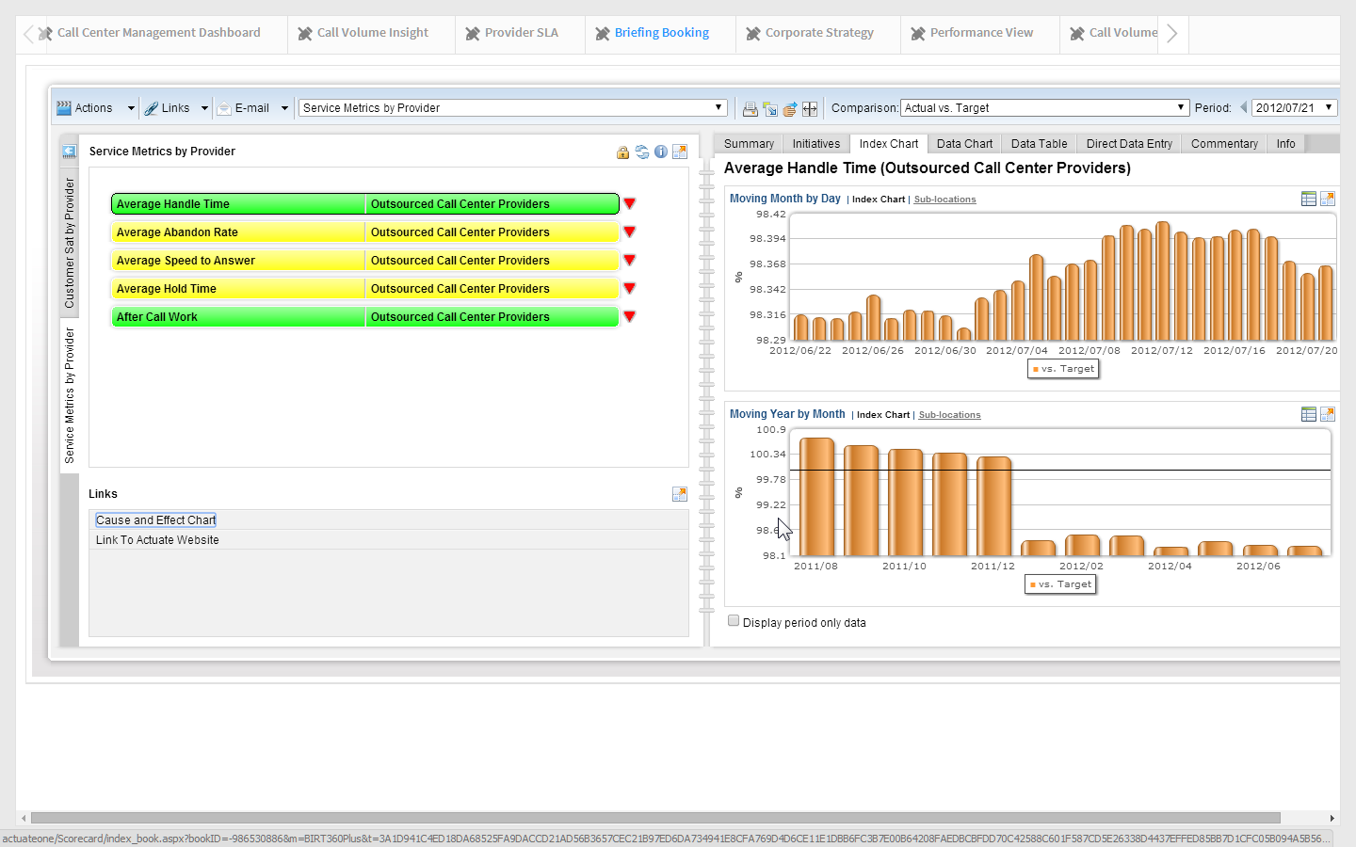
Notes:
Click the "SERVICE METRICS BY PROVIDER" page (left hand tabs of the book UI)
Point out the metrics and color coding.
Click the red Drilldown Icon to the right of the "AVAERAGE ABANDON RATE" measure to drill to the next level of the hierarchy, the providers themselves.
Lets look at our call center measures rolled up to the corporate level. The color coding follows the familiar traffic light metaphor where green is good, red is bad, and yellow is warning. Each measure assumes the color of corresponding to its current health, here we see that several of our measures are in a warning state! Each measure can drill to the next level, either to lower level measures, or to see how a given measure is performing across 'locations'. A BIRT Scorecard 'location' can be any organizational or operational entity in a company, such as 'region', 'territory', 'team' or 'campus'. In this case our outsourced providers are the locations, and based on the color-coded drilldown icon next to AVAERAGE ABANDON RATE I can see that there is an underlying issue.
When I click the icon I clearly see how each provider is performing in that measure.

Slide 29
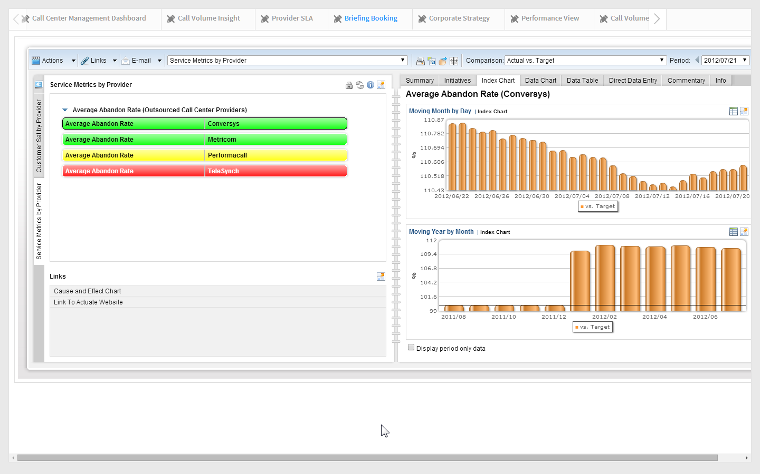
Notes:
Click the "AVERAGE ABANDON RATE" (red measure) for TeleSynch, point out the supplemental information dashboard tabs on the right side of the book, they are the same tabs we saw when drilling from the "Moving 30 Days" chart gadget earlier. Point out comment entered earlier.

Slide 30
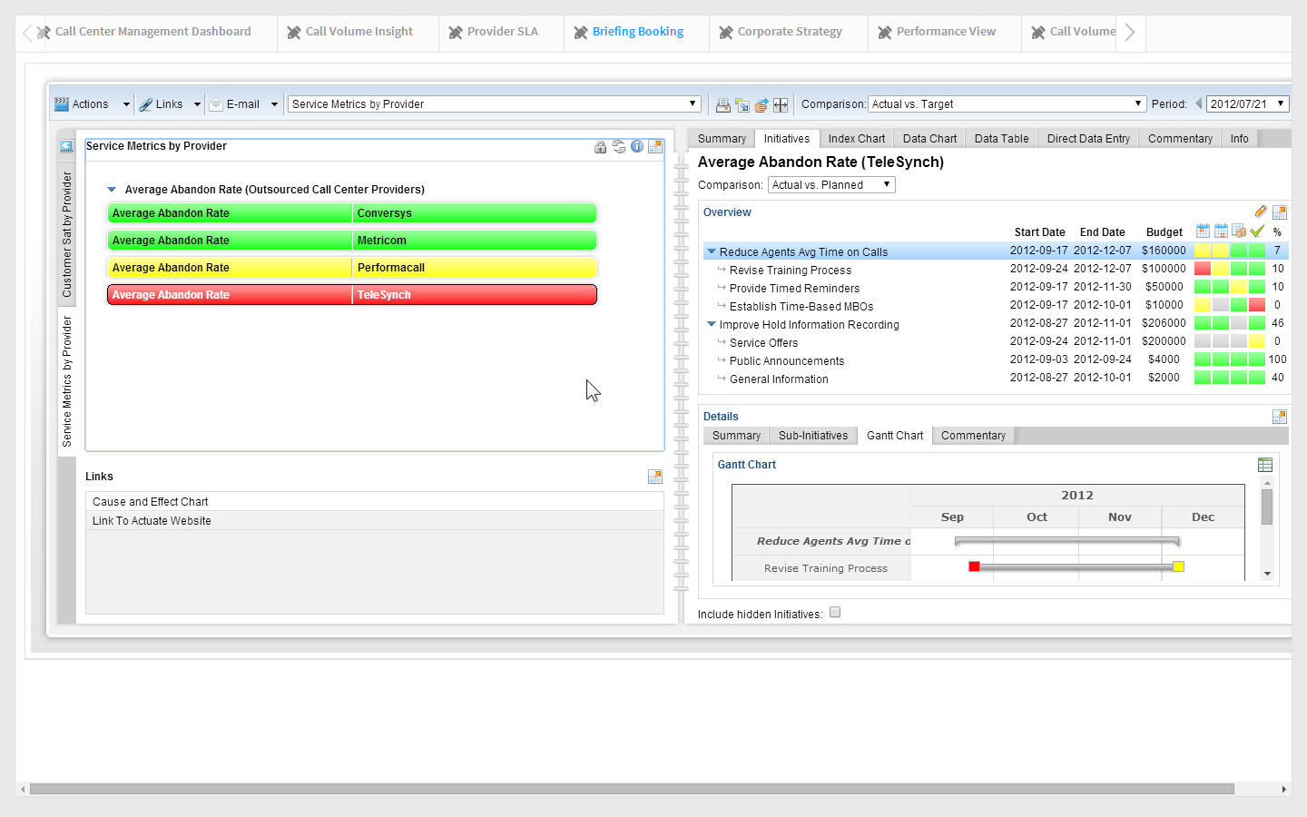
Notes:
Click the "INITIATIVES" tab in the supplemental information dashboard, under the 'details' section of the page click the GANTT CHART.
To facilitate continuous improvement, BIRT offers the ability to create and track IMPROVEMENT INITIATIVES from within the application itself! Tasks and activities to resolve the underlying issues for underperforming measures are defined and monitored in a simple graphic that depict the current status of each task. Initiative tasks statuses are conveyed using the same color coding as the measures themselves, keeping the entire experience in context for the user. In this way the BIRT system helps the organization improve by providing instant feedback for each step in the process, as initiative tasks turn green, so should the corresponding measures.

Slide 31
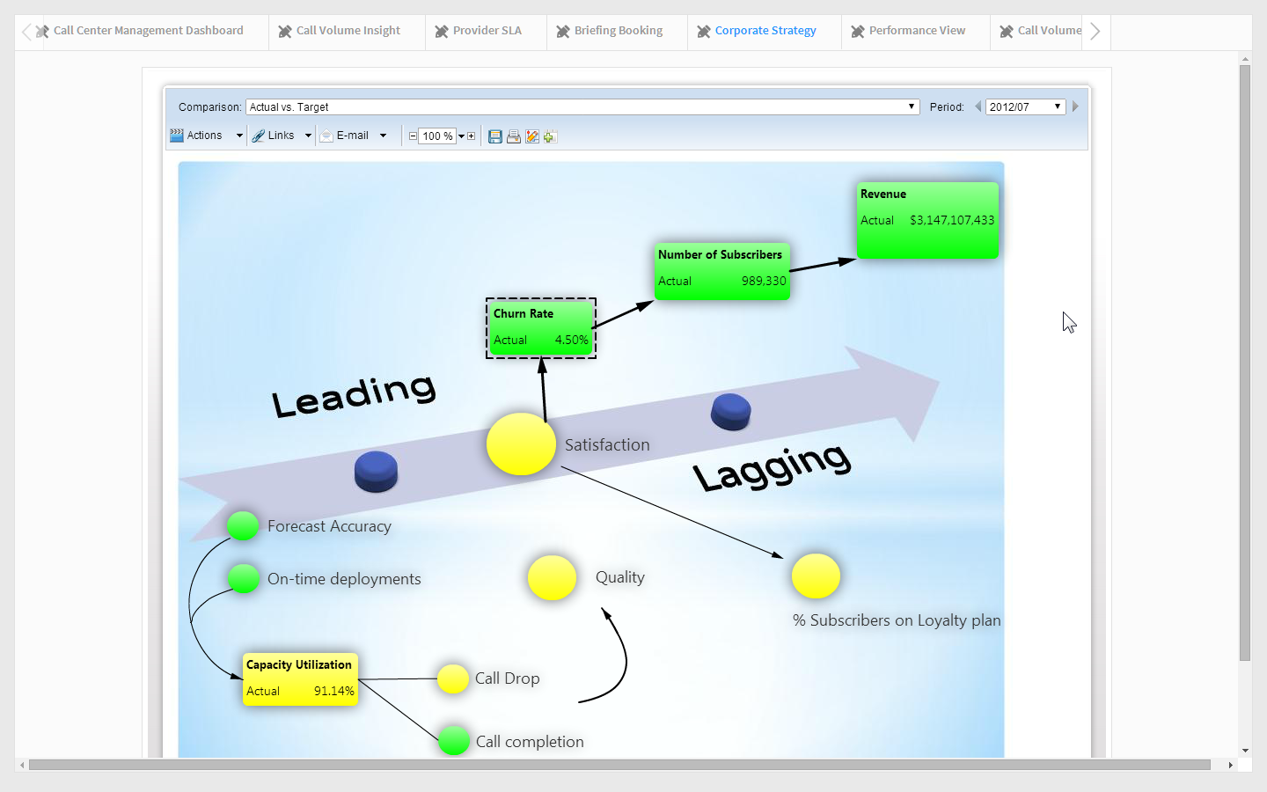
Notes:
"Corporate Strategy" dashboard tab
Lastly, BIRT offers an organization the ability to create and display STRATEGY MAPS, which are used to monitor key strategic corporate goals via dynamic color-coded measures overlaying any graphic. The interface provides advanced visualizations that can be used to map KPIs against strategies, processes or geographies to see alignment, observe process efficiencies or performance by geographies.
The reason to pitch this is that maps have uses beyond strategy management

